Slide 1
Image Object Database
Representations of segmented image objects
  Biological Context
  Image acquisition parameters
  Segmentation/Recognition Parameters
  Bitmaps: e.g. stacks of masked raw images
  Polygons: contours
  Symbolic: extracted features
  Classification by human expert (cell cycle phase)
  Mesh or wireframe models
Purpose
  Export of datasets for machine learning
    Model-based segmentation
    Model-based tracking
    Classification: e.g. cell cycle phase, cell type…
  Validation of computer vision tasks through visualization

Slide 2
Biological Context
Organism: e.g. Drosophila, human
Stage/ Age: embryogenesis, pupa, nuclear cycle 13
Tissue: e.g. head ectoderm, CNS,…
Cell Type: muscle, neuron, macrophage
Markers/reporters used: e.g. histone-GFP, repo-MKO, Hoechst, antibodies
Sample Preparation: Fixed or live samples
Genetic background. Mutation or over-expression
Drug treatment, heat-shock
Others…

Slide 3
Image Acquisition/File description
Type of microscope
Scanning: e.g. live or Meta (Zeiss), Galvo or Resonant (Nikon)
Embedding media: e.g. agarose, oil, water
Objective
Excitation wave length, laser, emission filter, detector
Image Dimensions, Number of Slices
Pixel and voxel dimensions
Time-lapse interval
Channels
Bit depth: 8-bit, 16 bit
File Format

Slide 4
Segmentation/Object Recognition
Algorithm Description: e.g. Ram’s 3D segmentation, Definiens rule-set, Thresholding,…
Parameters: example
  Conversion from 16 to 8 bits and contrast stretch
  Median filtering: 7x7 window size
  Global Threshold: 55
  Find Contours
  Link connected ROIs with min overlap of 50%
  Filtering: exclude small objects < 5 µm³

Slide 5
Symbolic Representation
Location in Scene
Shape features
Texture features
Associations with other objects:
  in different time points (tracking)
  Same object created by different segmentation (e.g. different algorithm or parameters)

Slide 6
Expert Classification
Phenotypic Classification
  Cell cycle phase: e.g. interphase, mitosis, G1 versus G2,…
  Cell Type: neurons, glia, muscle
  Apoptotic versus non-apoptotic
  Differentiated versus non-differentiated
Evaluation of Segmentation
  Correct, over- and under-segmentation

Slide 7

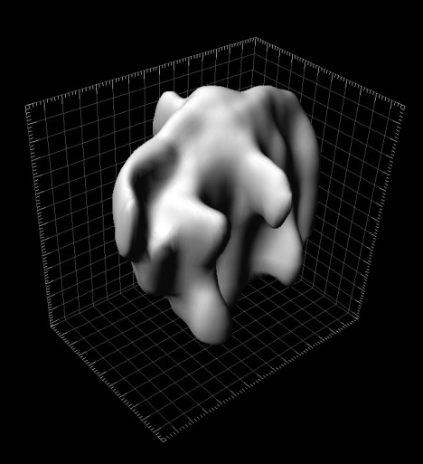
Visualization

Slide 8
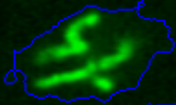
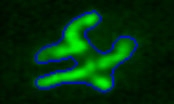
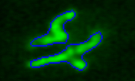

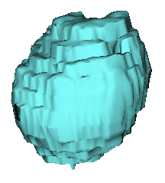

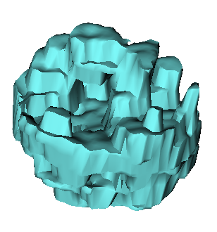
Visualization
Display contours extracted using different segmentation parameters
Same Object: different Thresholds
Threshold = 25
Threshold = 55
Threshold = 80
Threshold = 45
Threshold = 55

Slide 9

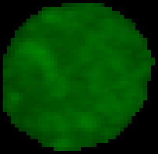
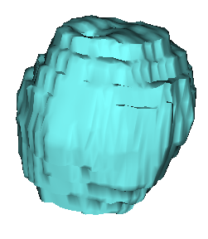
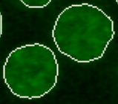
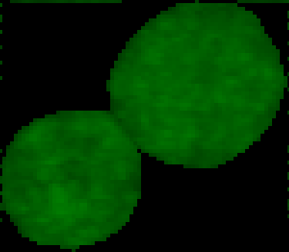
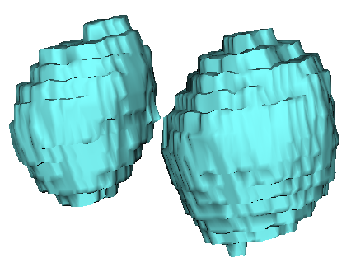
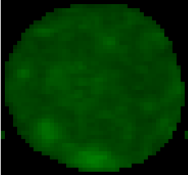
Visualization
Contours
MIP
Isosurface

Slide 10
Implementation
C++ .net
  Available libraries for visualization and computer vision
  Good performance
  Easy GUI programming
Database (ease of use, scalability)
  MySQL
  Flat files, e.g. .csv
  other suggestions?
Visualization Libraries
  VTK
  ?

